Slide 1
Lived Experiences of Poverty and Inequality: What we know and what needs to change
CAY AGM 25th October 2023
Maddy Power

Slide 2
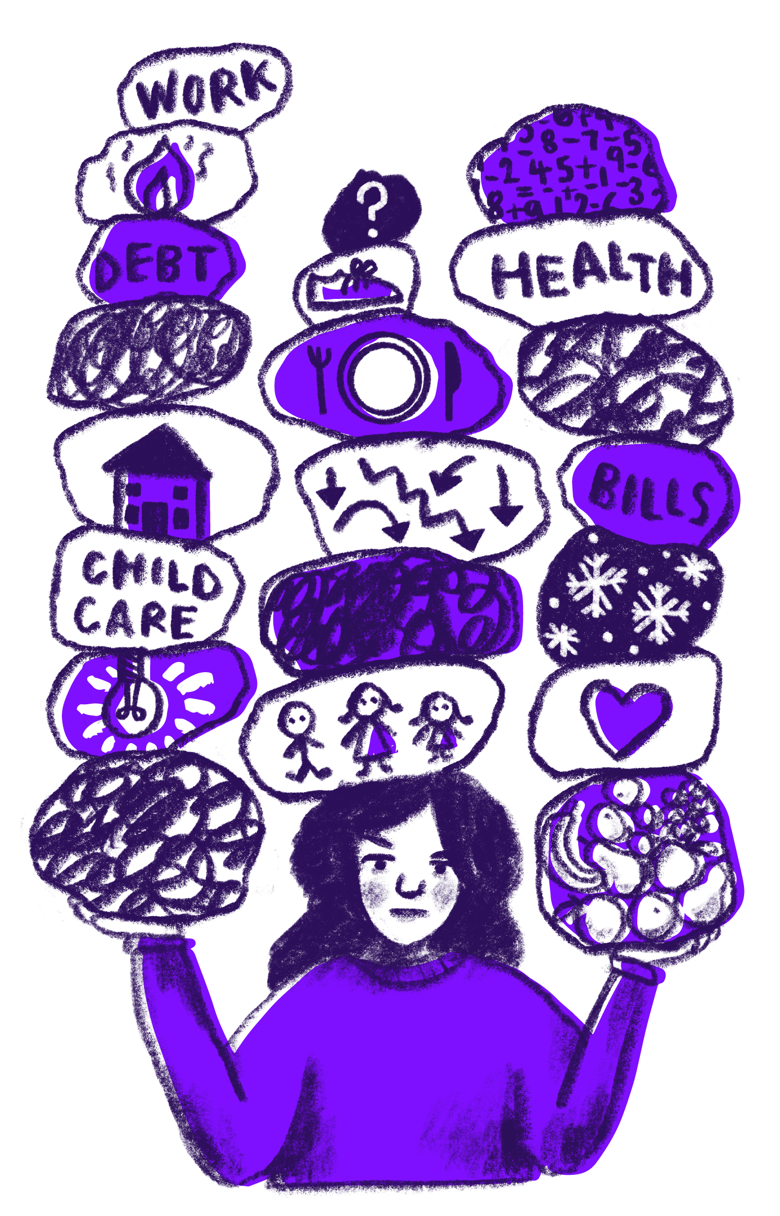
Poverty and inequality in the UK
13.4 million people were living in poverty in 2020/21.
Around one in five of our population (20%) were in poverty in 2020/21 - that's 13.4 million people. Of these:
7.9 million were working-age adults
3.9 million were children
1.7 million were pensioners.
Around 3.8 million people experienced destitution in 2022 – a 61% increase since 2019
This includes around 1 million children – an 88% increase since 2019
The number of people experiencing destitution in the UK has more than doubled in the last five years
Since 2017 the number of children experiencing destitution has almost tripled – an increase of 186%
The social security system is not protecting people from destitution: 72% of those destitute are in receipt of benefits
Source: https://www.jrf.org.uk/report/uk-poverty-2023

Slide 3
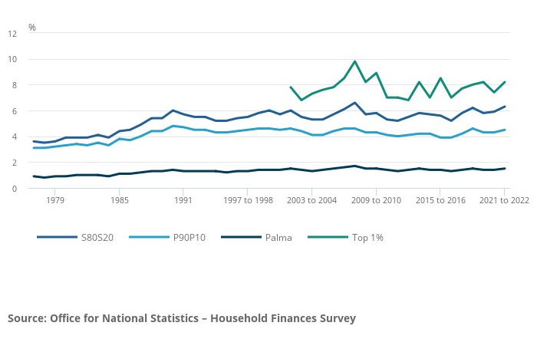
Inequality has increased to highest level over 10-year period
Notes:
of what families are missing out on
on th
e sacrifices parents make to keep their children warm
on the harm this is doing to parents mental health

Slide 6
Lived experiences of poverty and inequality
I use the heating sparingly and it’s mainly for the children, when they go to their dads I have an electric blanket that I got for free from my energy company and that keeps me warm if I’m sat. (Sal)
I feel crushed by the Government. As a lone parent in a low income for over 10 years, I am used to struggling financially. I always look for a way out of a hole , whether it's gaining more qualifications or taking on extra employment to find the Gov move the goal posts. This time the goal posts are off the pitch and placed down the road. I swing from anxiety to depressed and unmotivated. (Bessie)
Notes:
of what families are missing out on
on th
e sacrifices parents make to keep their children warm
on the harm this is doing to parents mental health

Slide 7
Lived experiences: The cost of living crisis isn’t over
Living with perpetual crisis
Harms caused by inadequate benefit levels
Fears about winter
Everything's going up. My mobile phone bill, they went up 10%. That's not come down. Nothing's come down. Food shopping hasn't come down. Nothing. We're just having to survive any way we can. It's definitely not getting any better, if not worse. (Roxy N)
The cost of living crisis is impacted a lot in my mental health because every day I am worried. How I can provide the food for my family what I can do extra to earn more money. I am feeling frustrated, sad, angry... (Rudy G)
I'm already fearing for winter and the extra bills. Basic food is still going up in price. If benefits don't also rise how can I feed the kids? I literally spend hours thinking how to cost cut but my belt cannot be tightened anymore! (Gabriel K)
Notes:
of the fear and insecurity the wait to hear about the uprating decision has caused
of the material struggle families are already facing

Slide 8
What needs to change?
We’re asking for a fundamental change in the way we are seen and treated within the system.
We want to be respected enough to not have to prove ourselves at every single turn.
We want enough money to live on so we can concentrate on improving our lot.
We want the common courtesy of advanced notice, clear explanations, appointments on time, and reciprocal understanding when things don’t happen as planned.
We want work coaches to actually support us, encourage us, and believe in us.
We want to be met with dignity and respect, as equals.
If society sees the government viewing us differently, supporting us properly, treating us well, caring about us, then slowly it will too.
Remove the stereotypes and talk to us as equals.
Not scroungers. Not lay-abouts. Not uneducated.
But as human beings, just like you, trying to do the best for our families, just like you.
Catherine, Covid Realities participant, extract from speech at parliamentary event, March 2021
Notes:
of what families are missing out on
on th
e sacrifices parents make to keep their children warm
on the harm this is doing to parents mental health

Slide 9
From Covid Realities to Changing Realities

Slide 10
What immediate changes are needed?
Increase benefit at least by inflation, unfreeze local housing allowance
Replace flat-rate and one-off payments with long-term investments, proportional to need
Abolish policies that punish families with children: the two-child limit and the benefit cap
Notes:
of what families are missing out on
on th
e sacrifices parents make to keep their children warm
on the harm this is doing to parents mental health

Slide 11
What radical longer terms reforms are needed?
But we also need more radical, longer term reforms including….
A willingness to openly talk about social security as an investment, and as a force for good
A thorough rethink of the role of conditionality and sanctions within employment ‘support’
Redressing the recent invisibility of children in packages of support - best achieved through increasing Child Benefit
Action to place dignity and respect at the heart of our social security system [rolling back on a reliance on negative, punitive rhetoric] and learning directly from people with lived experience
Notes:
of what families are missing out on
on th
e sacrifices parents make to keep their children warm
on the harm this is doing to parents mental health

Slide 12
What can we do?
Include people with lived experience in decision making and policy making.
Resist stigmatising narratives and divisions of working and non-working people.
Think about what can be done locally through claiming entitlement, campaigning for improvements, local networks and solidarity.
Vote - be informed and think critically, hold your representatives to account.
Notes:
of what families are missing out on
on th
e sacrifices parents make to keep their children warm
on the harm this is doing to parents mental health

Slide 13
Find out more
Changing Realities (https://changingrealities.org/), Covid Realities (https://covidrealities.org/ )
Get in touch to share your own experiences, ask questions and continue the conversation (www.changingrealities.org / changing-realities-project@york.ac.uk )
Notes:
of what families are missing out on
on th
e sacrifices parents make to keep their children warm
on the harm this is doing to parents mental health

Slide 14
Any questions, comments, thoughts?
Notes:
of what families are missing out on
on th
e sacrifices parents make to keep their children warm
on the harm this is doing to parents mental health

Slide 15
